Slide 1
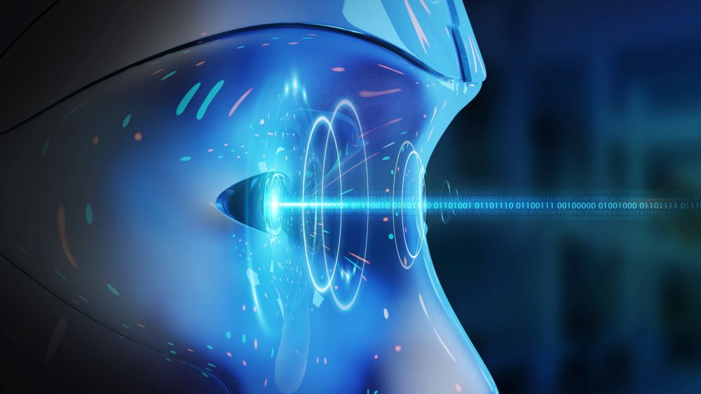
MINOR PROJECT
DEPARTMENT OF ELECTRONICS & COMMUNICATION ENGINEERING

Slide 2
Human Body Posture Analyzer

Slide 3
MANJULA M (927621BEC114)
TEAM MEMBERS
GUIDED BY
Mr.MOHANRAJ S [AP/ECE]

Slide 4
INTRODUCTION
A human posture detection system means identifying the change of posture in a speciﬁed area and detecting the range of human motion. Generally, it can be described quantitatively by the devices. Surface electromyography (sEMG) represents the bioelectrical activities of spinal cord motor neurons under the control of cerebral motor cortex, which can directly reﬂect the human motion intention and muscle state information with real-time interaction and non invasive and convenient operation . People move much less and work more often on the computer. Long-term sitting harms the spine and causes chronic problems that need long-time therapy .

Slide 5
INTRODUCTION CONTD.
Diseased people have a significant impact on office productivity. Our motivation is to help people pay attention to their health and proper sitting in addition to work. Adopting the correct sitting position is essential for maintaining good posture and a healthy back and spine. Sitting with a straight back and shoulders not only will improve a person’s physical health but also can make them feel more confident. Good posture means that the parts of a person’s body are correctly aligned and supported by the right amount of muscle tension. looked at the effect of sitting position on typing speed and overall well-being in people with chronic back pain

Slide 6
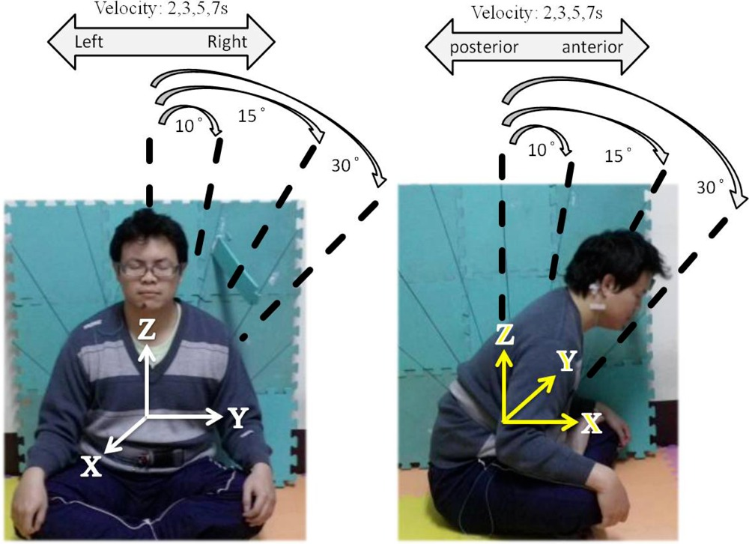
THEME INFO
Our goal is to detect a person from a perfect side view and measure the neck and torso inclination to some reference axis.
By monitoring the inclination angle when the person bends below a certain threshold angle. On the basis of the posture, whether good or bad, results are displayed. Other features indicate the bad posture by measuring the axis

Slide 7
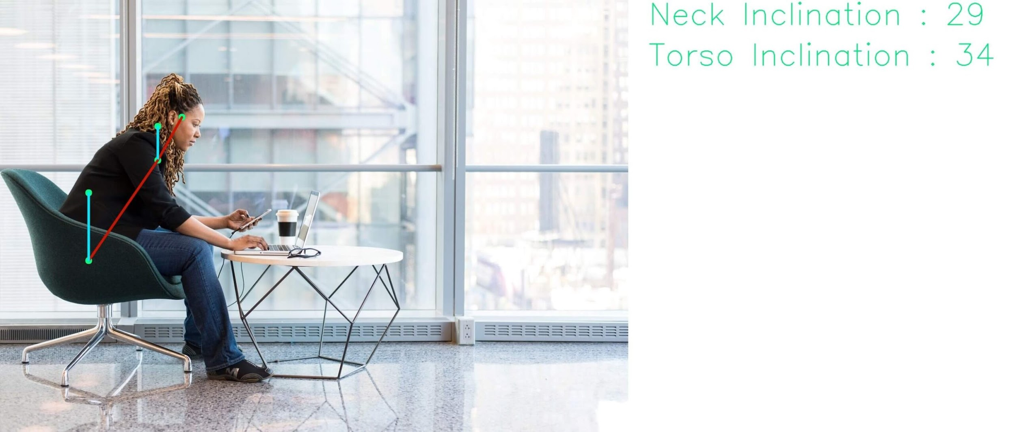
THEME INFO CONTD.
We need to make sure that the accelerometer have been placed correctly. Hence the alignment feature is required.

Slide 8
APPLICATION WORKFLOW
Power
Supply
Arduino
Accelerometer
Buzzer

Slide 9
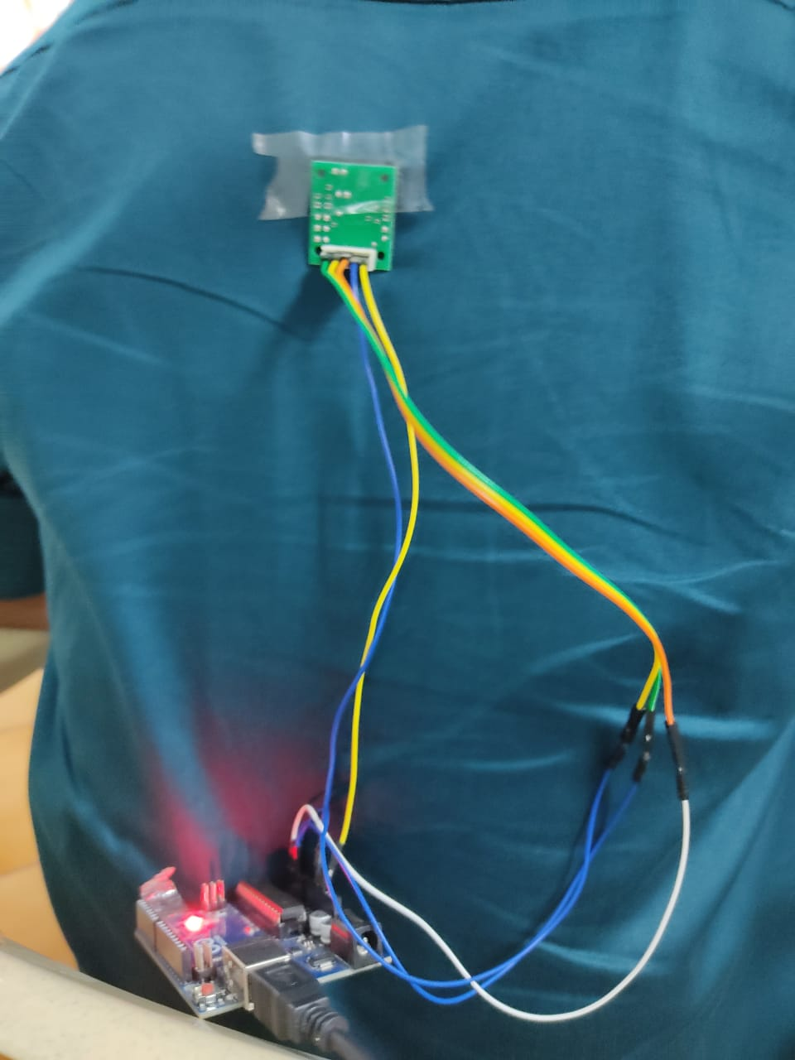
OUTCOME

Slide 10
CONCLUSION
So that’s all about building a posture indicator using accelerometer sensor . I hope this presentation helped you understand the basics of the Posture Analysis – a concept which is high-fidelity body pose tracking solution. Based on human pose, we can build a variety of applications, like fitness or yoga trackers.

Slide 11

Questions?

